Slide 1

Long short term Memory (LSTM)
Ashish Chouhan and Ajinkya PATIL

Slide 2
The Problem, Short-term Memory
Recurrent Neural Networks suffer from short-term memory.
If a sequence is long enough, they’ll have a hard time carrying information from earlier time steps to later ones.
If you are trying to process a paragraph of text to do predictions, RNN’s may leave out important information from the beginning.

Slide 3
The problem of Vanishing gradient
Why are vanishing gradients a problem?
In Deep Learning, each of the neural network's weights receive an update proportional to the partial derivate of the error function with respect to the current weight in each iteration of training.
In some cases, the gradient will be vanishingly small, effectively preventing the weight from changing its value.
In the worst case, this may completely stop the neural network from further training.

Slide 4
INTRODUCTION TO LSTM
Long-Short-Term Memory(LSTM) models are a type of Recurrent Neural Networks(RNNs) which has the ability to learn and remember over long sequences of input data through the use of “gates” which regulate the information flow of the network.
Long Short Term Memory networks – usually just called “LSTMs” – are a special kind of RNN, capable of learning long-term dependencies. They were introduced by Hochreiter & Schmidhuber (1997),

Slide 5
INTRODUCTION TO LSTM
LSTMs address the following limitations of RNNs.
Short-term memory — Discarding information from earlier time steps when moving to later ones, which result in the loss of important information.
Vanishing gradient — The gradient is the value used to update the weight used in a neural network. If a gradient value becomes extremely small, it doesn’t contribute too much to learning.

Slide 6
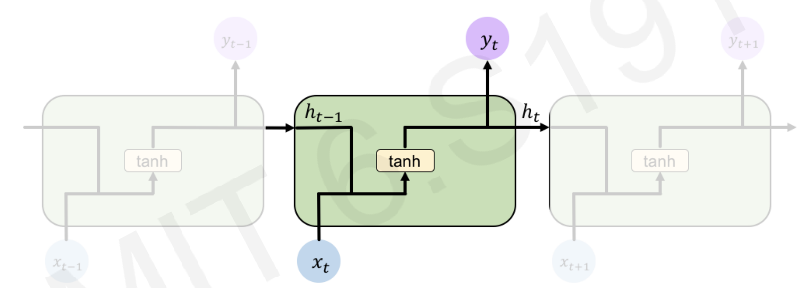
Standard RNN
In a standard RNN, repeating modules contain a simple computation node.

Slide 7
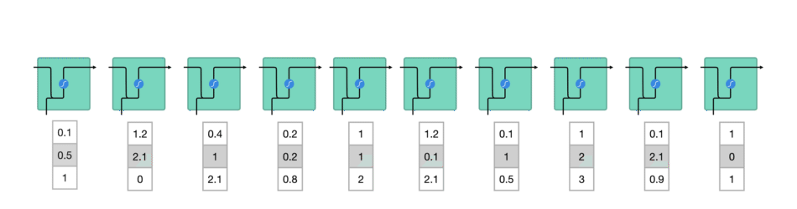
Standard RNN
Convert data to machine readable vectors.
Process vectors one-by-one.

Slide 8
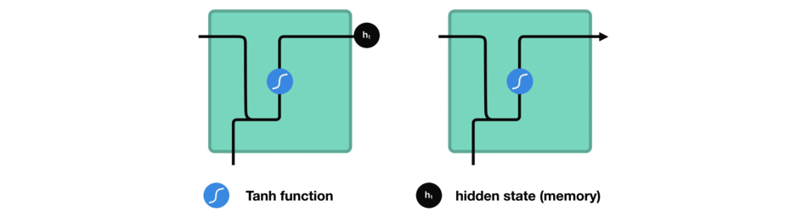
Standard RNN
Passes previous hidden state to next step of sequence.

Slide 9
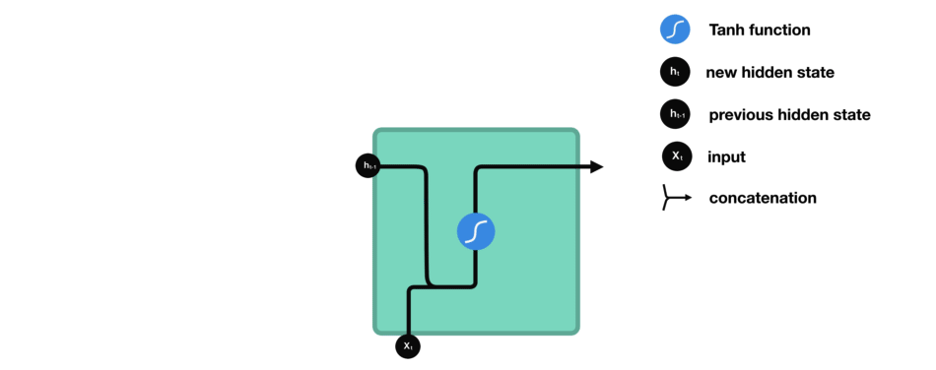
RNN VS LSTM
RNN
LSTM

Slide 10
LSTM - Overview
An LSTM cell consists of a cell state and input, forget and output gates which make use of several activation functions.
Both RNNs and LSTMs pass data as it propagates forward. However, unlike in RNNs, LSTMs makes use of gates to decide if it should keep or forget information.

Slide 11
LONG short Term memory (LSTM)
LSTM contains computational blocks to control the information flow.
LSTM cell blocks are able to track information through many timesteps.

Slide 12
LONG short Term memory (LSTM)
How LSTM works ?
1. Forget 2. Store 3. Update 4. Output
Information is added or removed by via a structure called as gates.

Slide 13
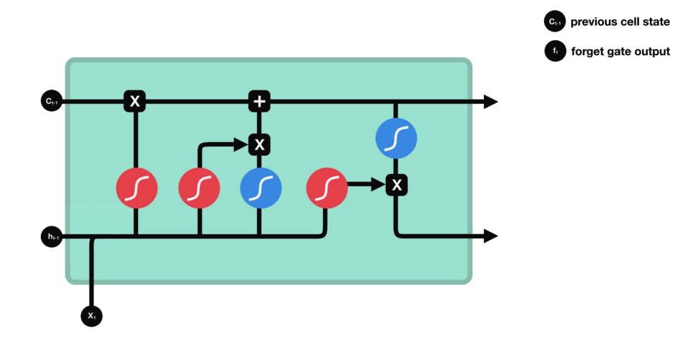
LSTM FORGET
LSTM forgets the irrelevant parts of previous steps.
Consider, h(t−1) and x(t) concatenation, and outputs a number between 0 and 1 for each number in the cell state
1 = Completely keep this
0 = Completely forget this

Slide 14
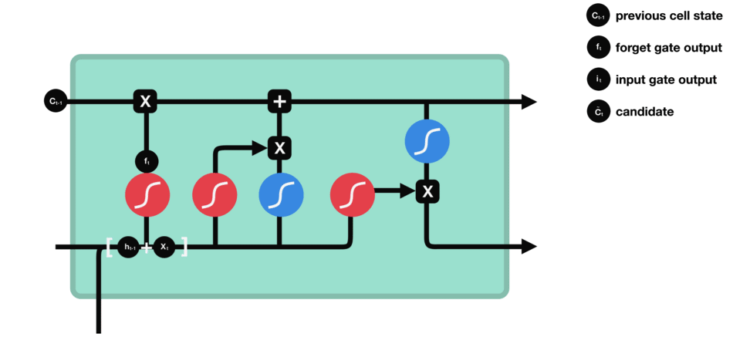
LSTM Input Gate
LSTM stores the relevant new information in the cell state.
To update the cell state, we have the input gate which decides which values will be updated.
A tanh layer creates a vector of new candidate values which will be carried forward.

Slide 15
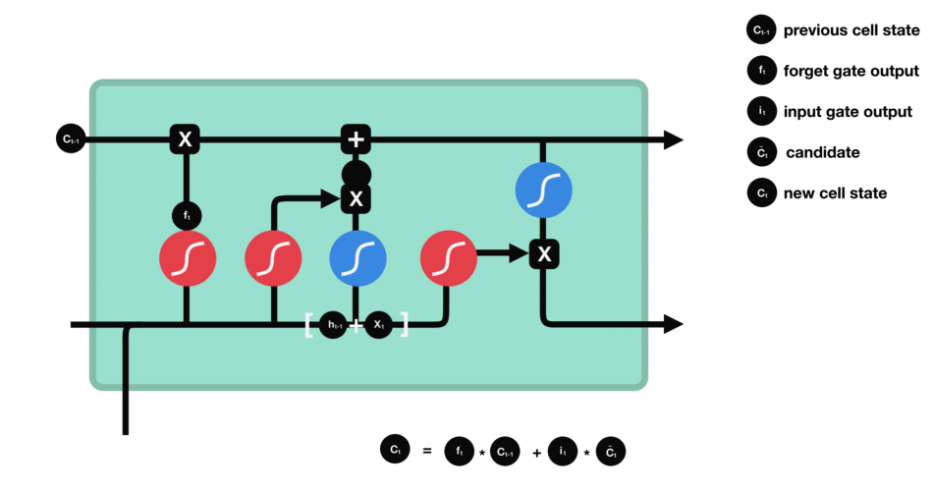
LSTM STORE/Cell State
LSTM selectively update cell state value
Multiplication f_{t} and cell state of previous cell C_{(t-1)}decide to forget
Then we add the current store state creating the current state C_{t}

Slide 16

LSTM Output
The output gate controls what information is sent to the next step
We run a sigmoid layer which decides what parts of the cell state we’re going to output. The things we remember.

Slide 17
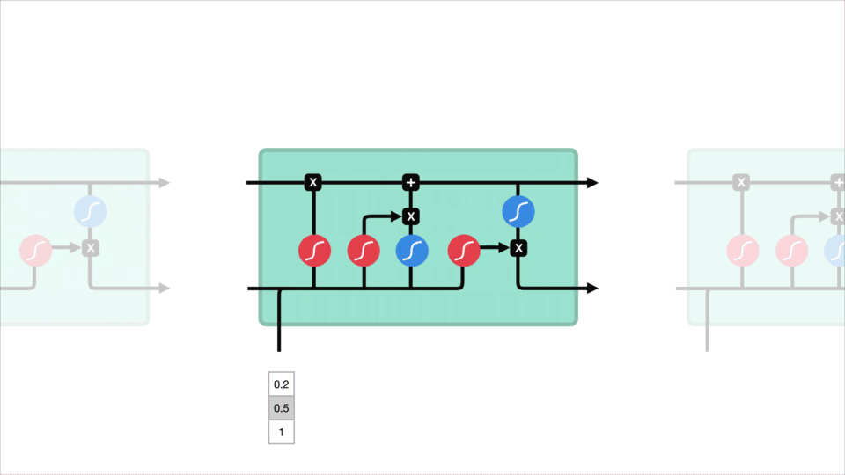
Long short term memory
1. Forget 2. Store 3. Update 4. Output

Slide 18
LSTM CELL in a function

Slide 19
LSTM – Key concepts
Forget gate — Decides which information should be kept and which should be discarded.
Input gate — Updates the cell state.
Output gate — Decides what the next hidden state(contains information on previous inputs) should be.
Cell state — Acts as a highway that transports relative information along the sequence chain.

Slide 20
LSTM Hyperparameters tuning tips
Regularization helps: regularization methods include l1, l2, and dropout among others.
The larger the network, the more powerful, but it’s also easier to overfit.
More data is almost always better, because it helps fight overfitting.
Train over multiple epochs (complete passes through the dataset).
Evaluate test set performance at each epoch to know when to stop (early stopping).

Slide 21

RNN and LSTM Applications
Music Generation
Input – Sheet Music
Output – Next Character in sheet music
Classic Example of many to many with input length != Output length.

Slide 22
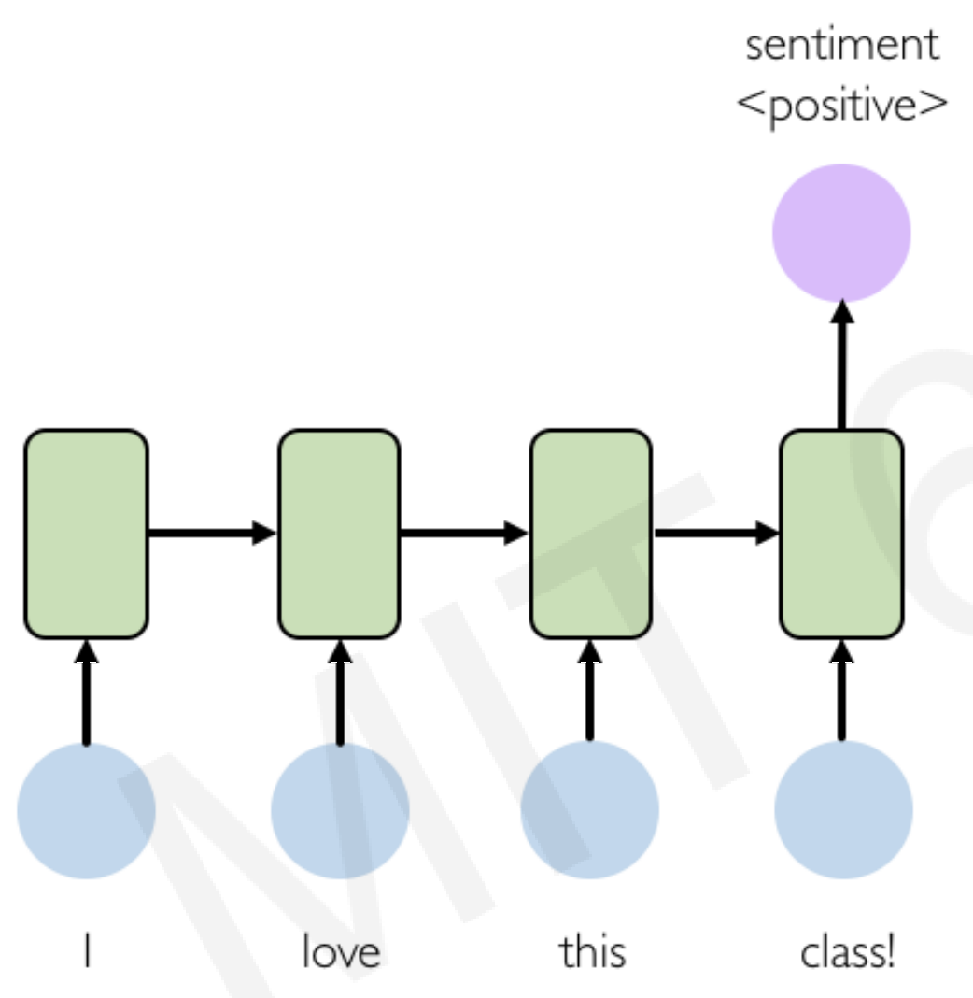
RNN and LSTM Applications
Sentiment Classification
Input – Sequence of words
Output - Probability of the sentiment.
Classic Example of many to 1.

Slide 23
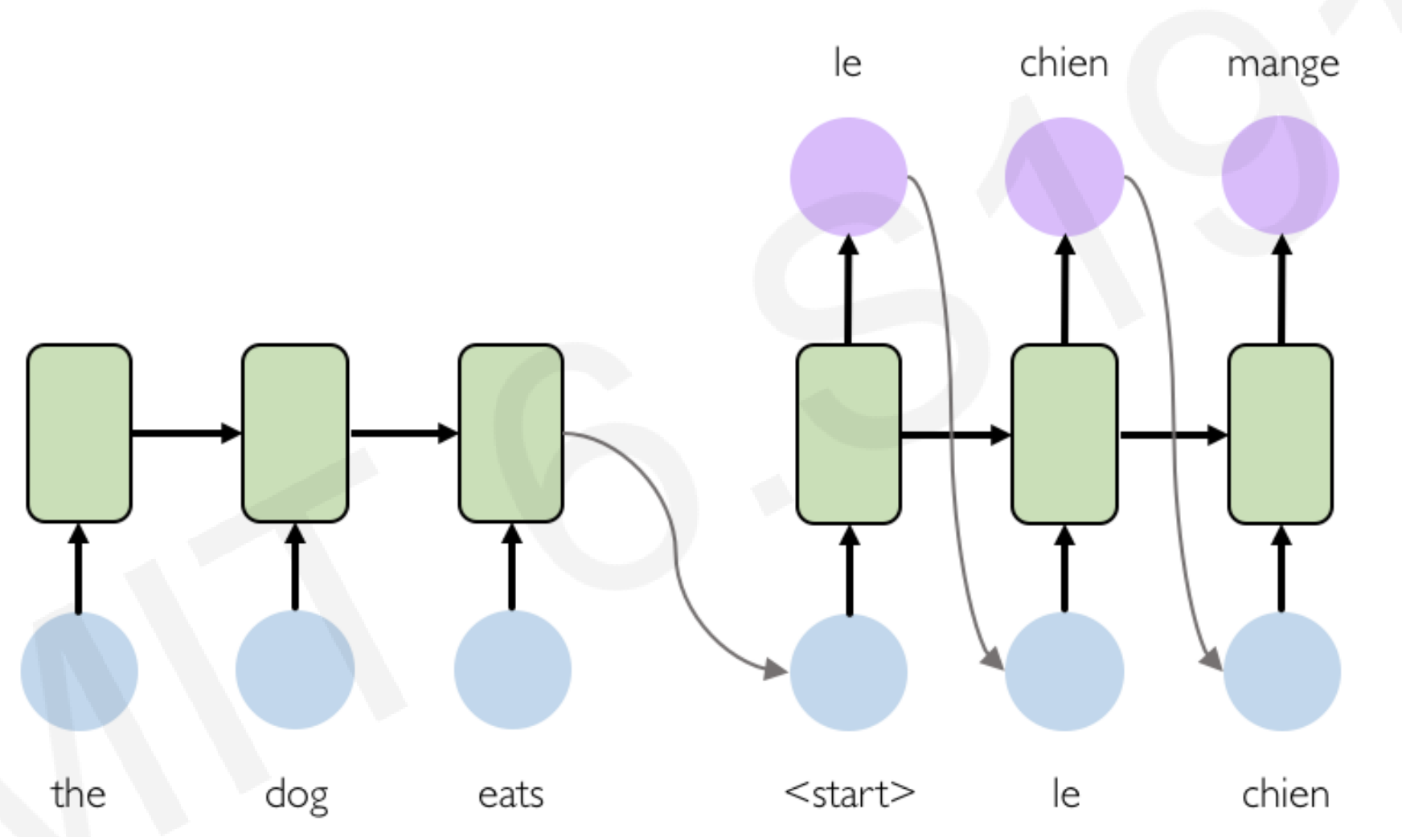
RNN and LSTM Applications
Machine Translation
Input – Sequence of words in origin language.
Output – Sequence of words in target language.
English (Encoder)
French (Decoder)

Slide 24
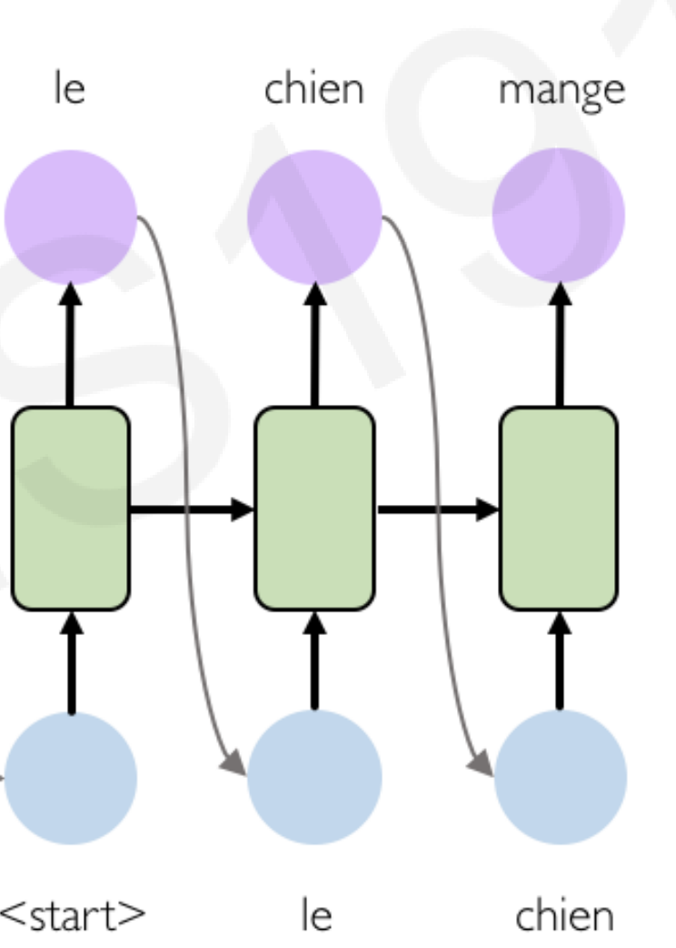
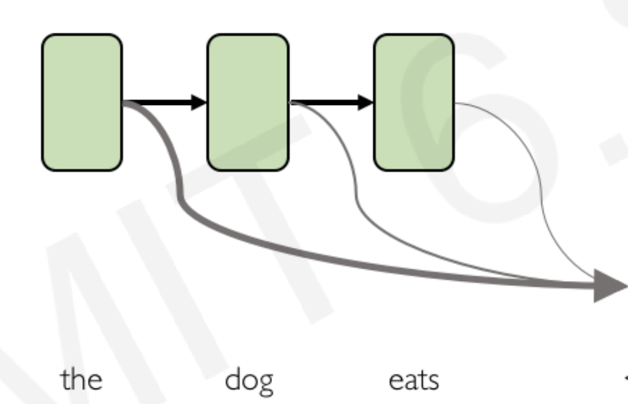
RNN and LSTM Applications
Machine Translation with attention mechanism
Input – Sequence of words in origin language.
Output – Sequence of words in target language.
English (Encoder)
French (Decoder)

Slide 25
RNN and LSTM Applications
Trajectory Prediction – Self-Driving Cars

Slide 26
Gated Recurrent units (GRU)
Gated recurrent units (GRUs) are a gating mechanism in recurrent neural networks, introduced in 2014 by Kyunghyun Cho. [paper]
The GRU is like a long short-term memory (LSTM) with forget gate but has fewer parameters than LSTM
The GRU does not have any output gate as opposed to the LSTM.

Slide 27
LSTM VS GRU

Slide 28
GRU Architechture
GRU is similar in structure as compared to LSTM
GRU got rid of cell state and used hidden state to transfer information
Replaced the forget and input gate with update gate
reset gate is another gate is used to decide how much past information to forget

Slide 29
GRU Summary
Gated recurrent neural networks are better at capturing dependencies for time series with large timestep distances.
Reset gates help capture short-term dependencies in time series.
Update gates help capture long-term dependencies in time series.

Slide 30
GRU LIMITATIONS
The LSTM is "strictly stronger" than the GRU the GRU fails to learn simple languages that are learnable by the LSTM as proved by Chung, Junyoung; Gulcehre, Caglar in their paper “Empirical Evaluation of Gated Recurrent Neural Networks on Sequence Modeling”.
Due to fewer gates the computation is faster but the control over learning mechanism is also traded-off.
Similarly, as shown by Denny Britz & Anna Goldie & Minh-Thang Luong & Quoc Le of Google Brain, LSTM cells consistently outperform GRU cells in "the first large-scale analysis of architecture variations for Neural Machine Translation "

Slide 31
Home work assignments – 1
Sentiment analysis of IMDB data.
By performing NLP based analysis predict the sentiment of the movie review use RNN and LSTM to compare.
Dataset available at - https://www.kaggle.com/lakshmi25npathi/imdb-dataset-of-50k-movie-reviews
Do not copy from other kernels (They are visible to US as well ☺ ).

Slide 32
Home work assignments – 2
“How much did it rain?” dataset on Kaggle (https://www.kaggle.com/c/how-much-did-it-rain-ii)
The task is a time series prediction. You have snapshots of polari-metric radar values and you have to predict the hourly rain gauge total. (some insights from the runner-up in the competition)
Do not copy from other kernels (They are visible to US as well ☺ ).

